Slide 1

Measuring the Cost of Living
0
24
P R I N C I P L E S O F
F O U R T H E D I T I O N
Notes:
This chapter can probably be covered in 1-1.5 class sessions.
It would be helpful if your students had calculators, so they can compute a CPI example and an example of using the CPI to compare dollar figures from different years.

Slide 2
In this chapter, look for the answers to these questions:
0
What is the Consumer Price Index (CPI)?
How is it calculated? What’s it used for?
What are the problems with the CPI? How serious are they?
How does the CPI differ from the GDP deflator?
How can we use the CPI to compare dollar amounts from different years? Why would we want to do this, anyway?
How can we correct interest rates for inflation?

Slide 3
The Consumer Price Index (CPI)
0
Measures the typical consumer’s cost of living.
The basis of cost of living adjustments (COLAs) in many contracts and in Social Security.

Slide 4
How the CPI Is Calculated
0
Fix the “basket.”
The Bureau of Labor Statistics (BLS) surveys consumers to determine what’s in the typical consumer’s “shopping basket.”
Find the prices.
The BLS collects data on the prices of all the goods in the basket.
Compute the basket’s cost.
Use the prices to compute the total cost of the basket.

Slide 5
How the CPI Is Calculated
0
Choose a base year and compute the index.
The CPI in any year equals
100 x
cost of basket in current year
cost of basket in base year
Compute the inflation rate.
The percentage change in the CPI from the preceding period.
inflation
rate
CPI this year – CPI last year
=
x 100%
CPI last year

Slide 6
EXAMPLE
0
basket: {4 pizzas, 10 lattes}
year
price of pizza
price of latte
cost of basket
2003
$10
$2.00
$10 x 4 + $2 x 10 = $60
2004
$11
$2.50
$11 x 4 + $2.5 x 10 = $69
2005
$12
$3.00
$12 x 4 + $3 x 10 = $78
Compute CPI in each year:
2003: 100 x ($60/$60) = 100
2004: 100 x ($69/$60) = 115
2005: 100 x ($78/$60) = 130
Inflation rate:
15%
13%
Notes:
Suggestion: Show students the data in the first three columns of the table. Before showing them the cost of basket calculations, tell them to take 3 minutes to compute the cost of the basket in each of the three years, and use those results to compute the value of the CPI in each of the three years. Then, show the rest of the slide.

Slide 7
A C T I V E L E A R N I N G 1:
Calculate the CPI
0
 | movie tickets | text-books
2004 | $10 | $50
2005 | $10 | $60
2006 | $12 | $60
The basket contains
20 movie tickets
and 10 textbooks.
The table shows their prices for 2004-2006.
The base year is 2004.
A. How much did the basket cost in 2004?
B. What is the CPI in 2005?
C. What is the inflation rate from 2005-2006?
Notes:
The three problems get progressively more challenging.
Most all students will know exactly how to solve part A.
Part B is not difficult but requires an intermediate step: students must compute the cost of the basket in 2005 (and use their answer from part A) to find the CPI in 2005.
Part C has two intermediate steps: computing the cost of the basket in 2006, then computing the CPI in 2006.

Slide 8
A C T I V E L E A R N I N G 1:
Answers
0
 | movie tickets | text-books
2004 | $10 | $50
2005 | $10 | $60
2006 | $12 | $60
The basket contains
20 movie tickets
and 10 textbooks.
A. How much did the basket cost in 2004?
($10 x 20) + ($50 x 10) = $700
Notes:
Most students will find this part easy.

Slide 9
A C T I V E L E A R N I N G 1:
Answers
0
 | movie tickets | text-books
2004 | $10 | $50
2005 | $10 | $60
2006 | $12 | $60
The basket contains
20 movie tickets
and 10 textbooks.
B. What is the CPI in 2005?
cost of basket in 2005
= ($10 x 20) + ($60 x 10) = $800
CPI in 2005 = 100 x ($800/$700) = 114.3

Slide 10
A C T I V E L E A R N I N G 1:
Answers
0
 | movie tickets | text-books
2004 | $10 | $50
2005 | $10 | $60
2006 | $12 | $60
The basket contains
20 movie tickets
and 10 textbooks.
C. What is the inflation rate from 2005-2006?
cost of basket in 2006
= ($12 x 20) + ($60 x 10) = $840
CPI in 2006 = 100 x ($840/$700) = 120
Inflation rate = (120 – 114.3)/114.3 = 5%
Notes:
Point out the following: From 2004-2005, the price of textbooks rises 20% and the inflation rate is 14.3%. From 2005-2006, the price of movie tickets rises 20%, and the inflation rate is only 5%.
Explanation: Spending on textbooks is a bigger proportion of total spending, so increases in the price of textbooks have a bigger impact on the CPI than increases in the price of movie tickets.

Slide 11
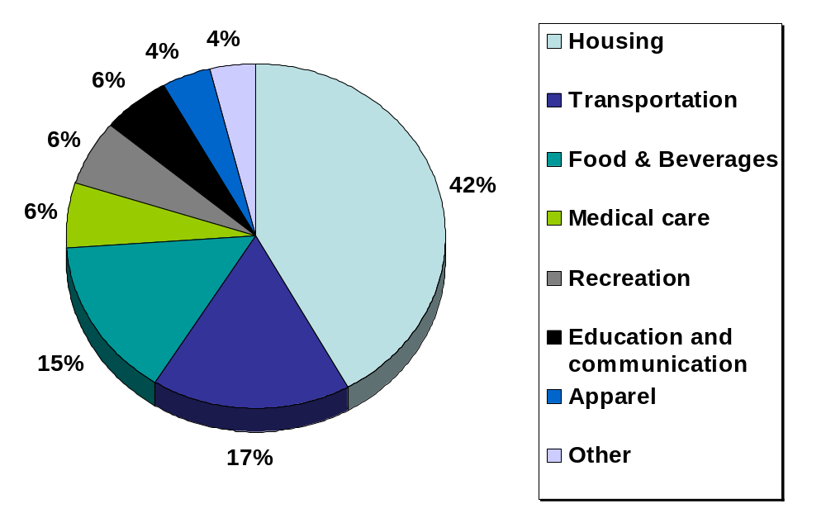
What’s in the CPI’s Basket?
0
Notes:
This slide replicates Figure 24-1 from the text.
Source: Bureau of Labor Statistics, http://www.bls.gov/cpi/
This graph shows just a few highly aggregated categories. A more detailed breakdown is available at the BLS website: look for “Relative Importance of Components in the Consumer Price Index” there.

Slide 12
Problems With the CPI:
Substitution Bias
0
Over time, some prices rise faster than others.
Consumers substitute toward goods that become relatively cheaper.
The CPI misses this substitution because it uses a fixed basket of goods.
Thus, the CPI overstates increases in the cost of living.

Slide 13
Problems With the CPI:
Introduction of New Goods
0
When new goods become available,
variety increases,
allowing consumers to find products
that more closely meet their needs.
This has the effect of making each dollar more valuable.
The CPI misses this effect because it uses a fixed basket of goods.
Thus, the CPI overstates increases in the cost of living.

Slide 14
Problems With the CPI:
Unmeasured Quality Change
0
Improvements in the quality of goods in the basket increase the value of each dollar.
The BLS tries to account for quality changes,
but probably misses some quality improvements, as quality is hard to measure.
Thus, the CPI overstates increases in the cost of living.

Slide 15
Problems With the CPI
0
Each of these problems causes the CPI to overstate cost of living increases.
The BLS has made technical adjustments,
but the CPI probably still overstates inflation
by about 0.5 percent per year.
This is important, because Social Security payments and many contracts have COLAs tied to the CPI.
Notes:
In the 1990s, it was estimated that the CPI’s bias cost taxpayers $1 trillion every 12 years in unnecessary COLAs in Social Security and government pension payments!!!

Slide 16
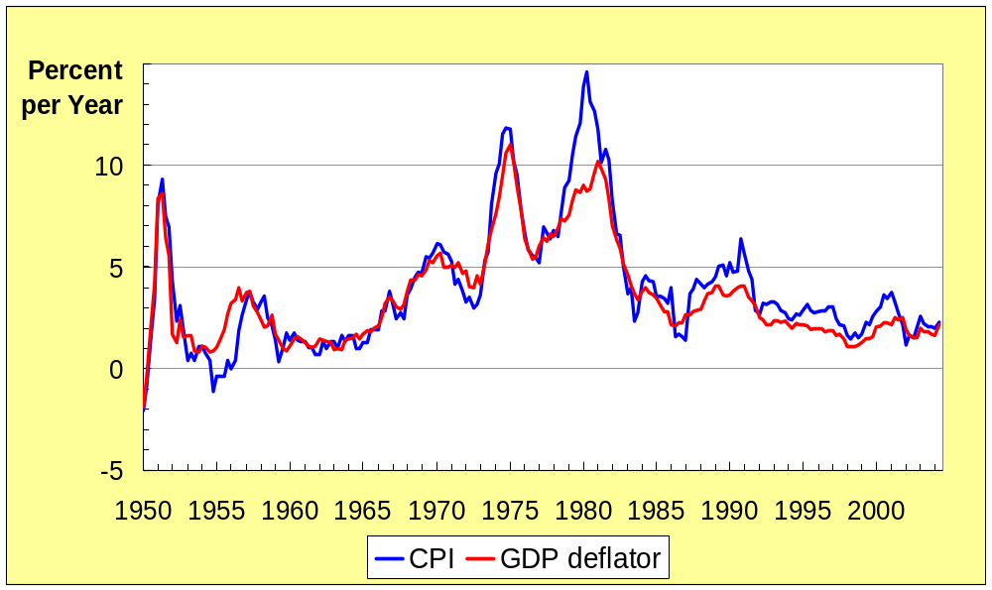
Two Measures of Inflation
0
Notes:
This figure shows the inflation rate – the percentage change in the level of prices – as measured by the GDP deflator and the Consumer Price Index using quarterly data from the U.S. economy.
Notice that the two measures of inflation generally move together. There are a few years when they diverge a bit. The reasons for this are on the next slide.
Source:
GDP deflator – Bureau of Economic Analysis, U.S. Dept of Commerce
CPI – Bureau of Labor Statistics, U.S. Dept of Labor
I obtained both from the Federal Reserve Bank of St. Louis “Fred” database:
http://research.stlouisfed.org/fred2/

Slide 17
Contrasting the CPI and GDP Deflator
0
Imported consumer goods:
  included in CPI
  excluded from GDP deflator
Capital goods:
  excluded from CPI
  included in GDP deflator (if produced domestically)
The basket:
  CPI uses fixed basket
  GDP deflator uses basket of
  currently produced goods & services
This matters if different prices are
changing by different amounts.

Slide 18
A C T I V E L E A R N I N G 2:
CPI vs. GDP deflator
0
In each scenario, determine the effects on the
CPI and the GDP deflator.
  A. Starbucks raises the price of Frappuccinos.
  B. Caterpillar raises the price of the industrial tractors it manufactures at its Illinois factory.
  C. Armani raises the price of the Italian jeans it sells in the U.S.
Notes:
If you wish to make this more challenging, move the preceding slide so that it appears immediately after the answers to this exercise.
If you are outside the U.S., please make the following changes:
in (b), change the example to “A local manufacturer raises the price on industrial tractors it produces.”
in (c), change “U.S.” to your country’s name, unless your country’s name is Italy.
(If your country is Italy, then change the example to something involving an imported consumer good.)

Slide 19
A C T I V E L E A R N I N G 2:
Answers
0
A. Starbucks raises the price of Frappuccinos.
The CPI and GDP deflator both rise.
B. Caterpillar raises the price of the industrial tractors it manufactures at its Illinois factory.
The GDP deflator rises, the CPI does not.
C. Armani raises the price of the Italian jeans it sells in the U.S.
The CPI rises, the GDP deflator does not.
Notes:
Explanations:
A. Frappuccinos are produced in the U.S., so their prices are part of the GDP deflator. They are purchased by consumers, so their prices are part of the CPI. Hence, an increase in the price of Frappuccinos causes both the CPI and GDP deflator to increase.
B. Since the tractors are produced here in the U.S., the price increase causes the GDP deflator to rise. However, industrial tractors are a capital good, not a consumer good, so the CPI is unaffected.
C. Italian jeans appear in the U.S. consumer’s shopping basket, and hence the increase in their price causes the CPI to rise. However, the GDP deflator is unchanged, because it only includes prices of domestically produced goods, and excludes the prices of imports.

Slide 20
Correcting Variables for Inflation:
Comparing Dollar Figures from Different Times
0
Inflation makes it harder to compare dollar amounts from different times.
We can use the CPI to adjust figures so that they can be compared.

Slide 21
EXAMPLE: The High Price of Gasoline
0
Price of a gallon of regular unleaded gas:
  $1.42 in March 1981
  $2.50 in August 2005
To compare these figures, we will use the CPI to express the 1981 gas price in “2005 dollars,”
what gas in 1981 would have cost if the
cost of living were the same then as in 2005.
Multiply the 1981 gas price by
the ratio of the CPI in 2005 to the CPI in 1981.
Notes:
Source of data: Bureau of Labor Statistics, www.bls.gov

Slide 22
EXAMPLE: The High Price of Gasoline
0
date
Price of gas
CPI
Gas price in 2005 dollars
3/1981
$1.42/gallon
88.5
$3.15/gallon
8/2005
$2.50/gallon
196.4
$2.50/gallon
1981 gas price in 2005 dollars
= $1.42 x 196.4/88.5
= $3.15
After correcting for inflation, gas was more expensive in 1981.
Notes:
Thus, if the cost of living in 1981 had been the same as it was in 2005, the price of gas in 1981 would have been $3.15/gallon.

Slide 23
A C T I V E L E A R N I N G 3:
Exercise
0
1980: CPI = 90,
avg starting salary for econ majors = $24,000
Today: CPI = 180,
avg starting salary for econ majors = $50,000
Are econ majors better off today or in 1980?
Notes:
These data are hypothetical. Neither I, nor Greg Mankiw, nor Thomson/South-Western can be held responsible if students subliminally acquire the perception that majoring in economics is a good thing to do.

Slide 24
A C T I V E L E A R N I N G 3:
Answers
0
1980: CPI = 90,
avg starting salary for econ majors = $24,000
Today: CPI = 180,
avg starting salary for econ majors = $50,000
Solution
Convert 1980 salary into “today’s dollars”
$24,000 x (180/90) = $48,000.
After adjusting for inflation, salary is higher today than in 1980.

Slide 25
Correcting Variables for Inflation:
Indexation
0
A dollar amount is indexed for inflation
if it is automatically corrected for inflation
by law or in a contract.
For example, the increase in the CPI automatically determines
  the COLA in many multi-year labor contracts
  the adjustments in Social Security payments and federal income tax brackets

Slide 26
Correcting Variables for Inflation:
Real vs. Nominal Interest Rates
0
The nominal interest rate:
  the interest rate not corrected for inflation
  the rate of growth in the dollar value of a
  deposit or debt
The real interest rate:
  corrected for inflation
  the rate of growth in the purchasing power of a deposit or debt
Real interest rate
= (nominal interest rate) – (inflation rate)

Slide 27
Real and Nominal Interest Rates: EXAMPLE
0
Deposit $1,000 for one year.
Nominal interest rate is 9%.
During that year, inflation is 3.5%.
Real interest rate
= Nominal interest rate – Inflation
= 9.0% – 3.5% = 5.5%
The purchasing power of the $1000 deposit
has grown 5.5%.
Notes:
31

Slide 28
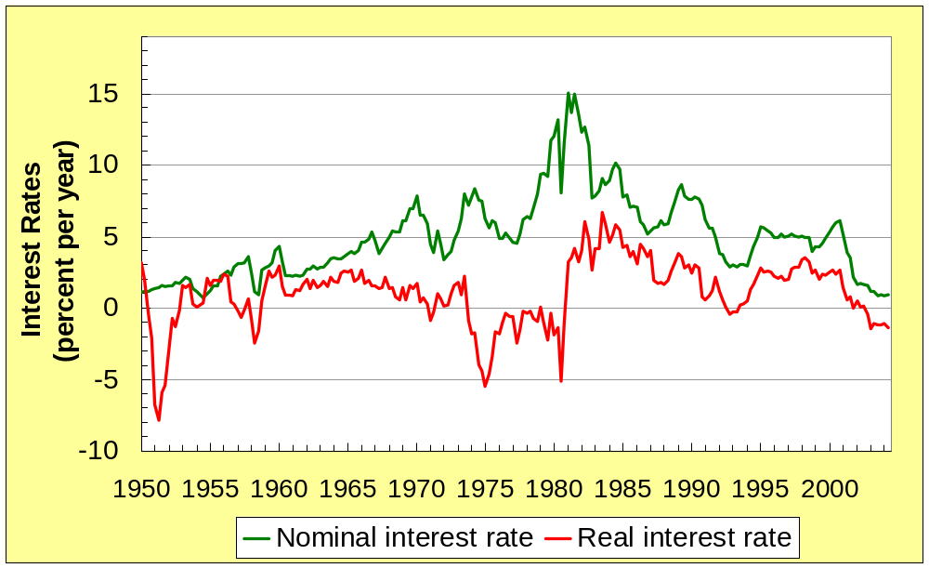
Real and Nominal Interest Rates in the U.S.
0
Notes:
This graph replicates Figure 3 from this chapter. The figure is constructed using quarterly data from the U.S.
The nominal interest rate is the rate on a three-month Treasury Bill. The real interest rate is the same, minus the inflation rate as measured by the percentage change in the CPI.
Notice that the nominal and real interest rates often do not move together, indicating that the real interest rate varies over time.
Sources:
CPI – Bureau of Labor Statistics
Treasury bill rate – Board of Governors of the Federal Reserve System.
I obtained both from the Federal Reserve Bank of St. Louis “Fred” database:
http://research.stlouisfed.org/fred2/

Slide 29
CHAPTER SUMMARY
0
The Consumer Price Index is a measure of the cost of living. The CPI tracks the cost of the typical consumer’s “basket” of goods & services.
The CPI is used to make Cost of Living Adjustments, and to correct economic variables for the effects of inflation.
The real interest rate is corrected for inflation,
and is computed by subtracting the inflation rate from the nominal interest rate.

